Slide 1
Tea Culture in China
By Eric Spencer

Slide 2
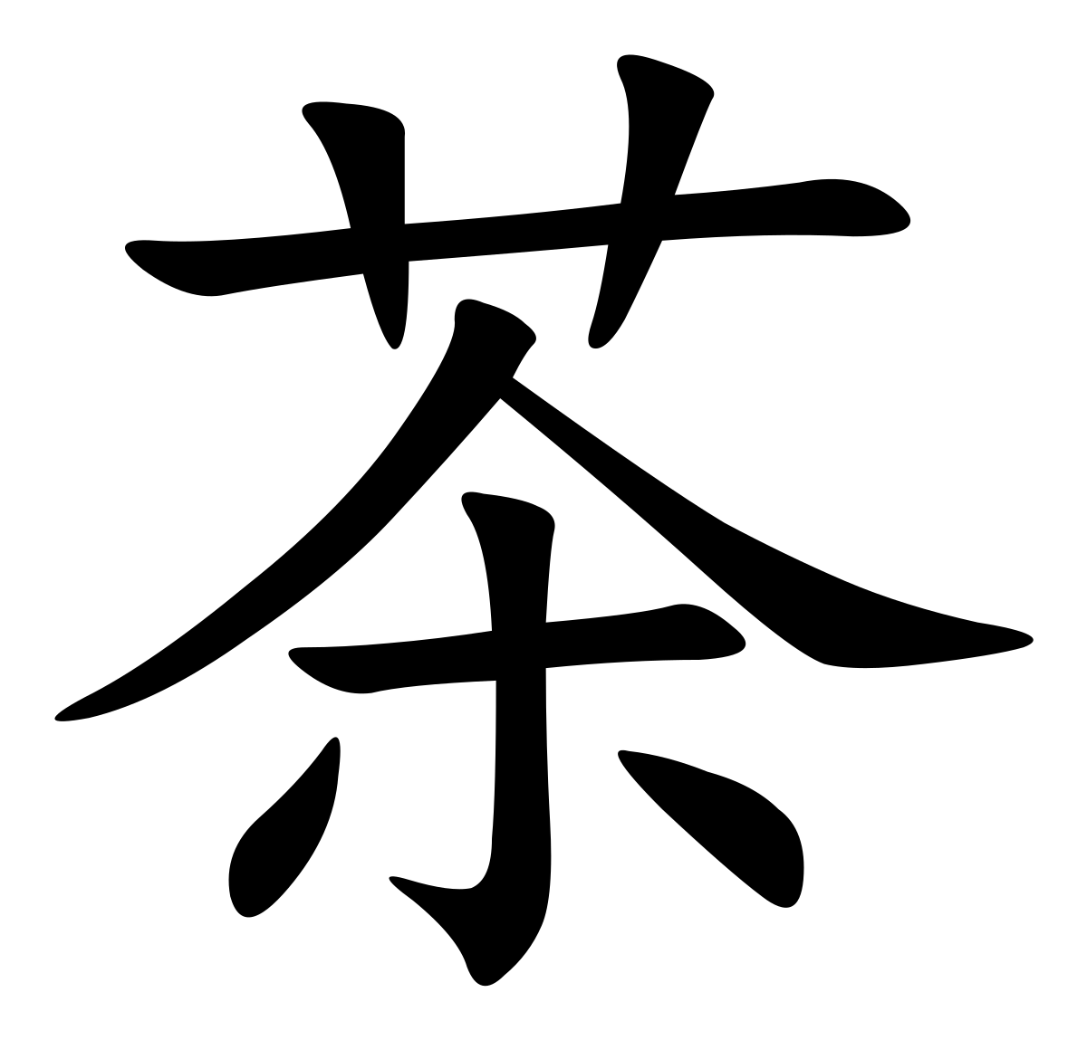
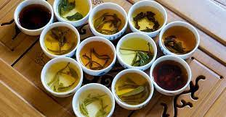
Chá

Slide 3
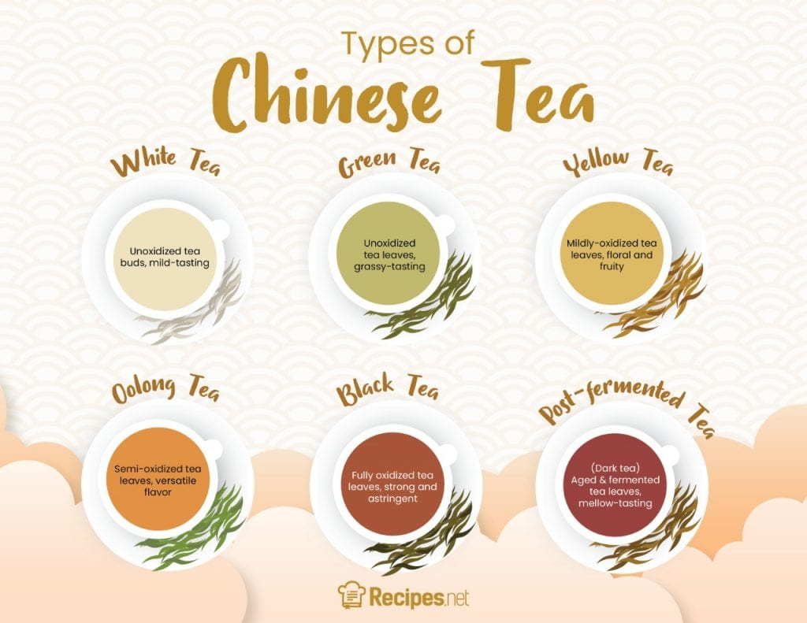

Slide 4
Tea Types (1)
Oolong, semi-oxidized tea that has darker colors than green, has a more complex flavor profile
Black, fully oxidized, bold flavor often paired with milk and sugar
Green, un-oxidized tea that is subtle in flavor and enjoyed alone without any additives
Yellow, rare and expensive, similar to green but goes through an extra step in the processing phase that turns the green leaves yellow, milder taste
White, un-oxidized tea that has a delicate flavor and pale color, least amount of steps of all the teas
Post-Fermented, tea is allowed to ferment, stopped, then allowed to ferment again that gives this tea a unique flavor and aroma
https://www.theteaspot.com/pages/about-tea

Slide 5
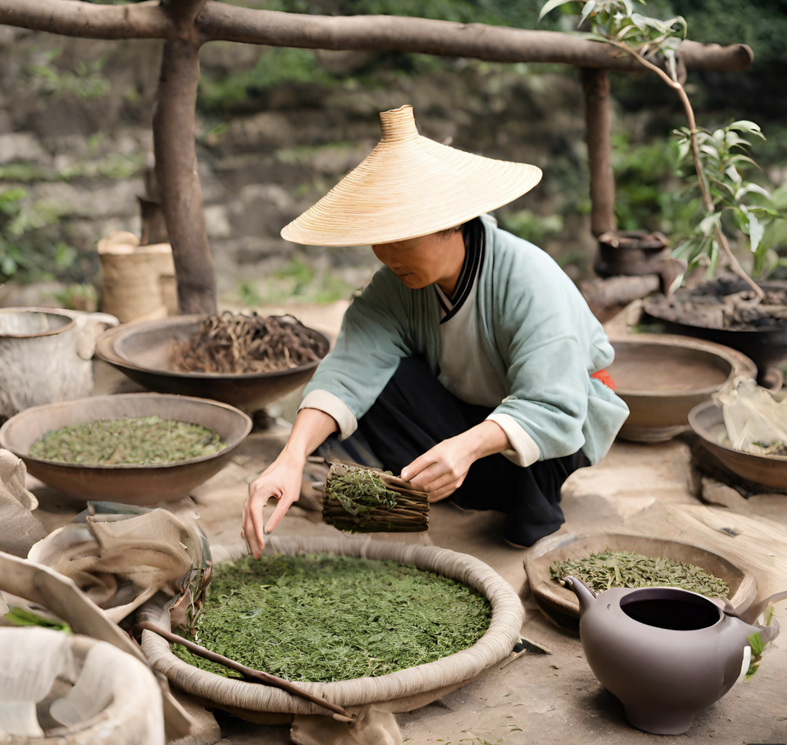
Background of Tea in China
Existed for more than 3000 years
Coexists with the ideas of Confucianism:
  Nature, Pleasure, Harmony, etc.
Believed to have healing properties
The Silk Road

Slide 6
The Silk Road
The trade routes that connected Asia with the Mediterranean and European world for 1,500+ years.
Trading goods led to the success of nations (1)
Cultural exchange allowed for the spread of ideas, such as religion and art (1)
Some consider the Silk Road to be fundamental to the success of human civilization (1)
https://en.unesco.org/silkroad/knowledge-bank/great-silk-road

Slide 7
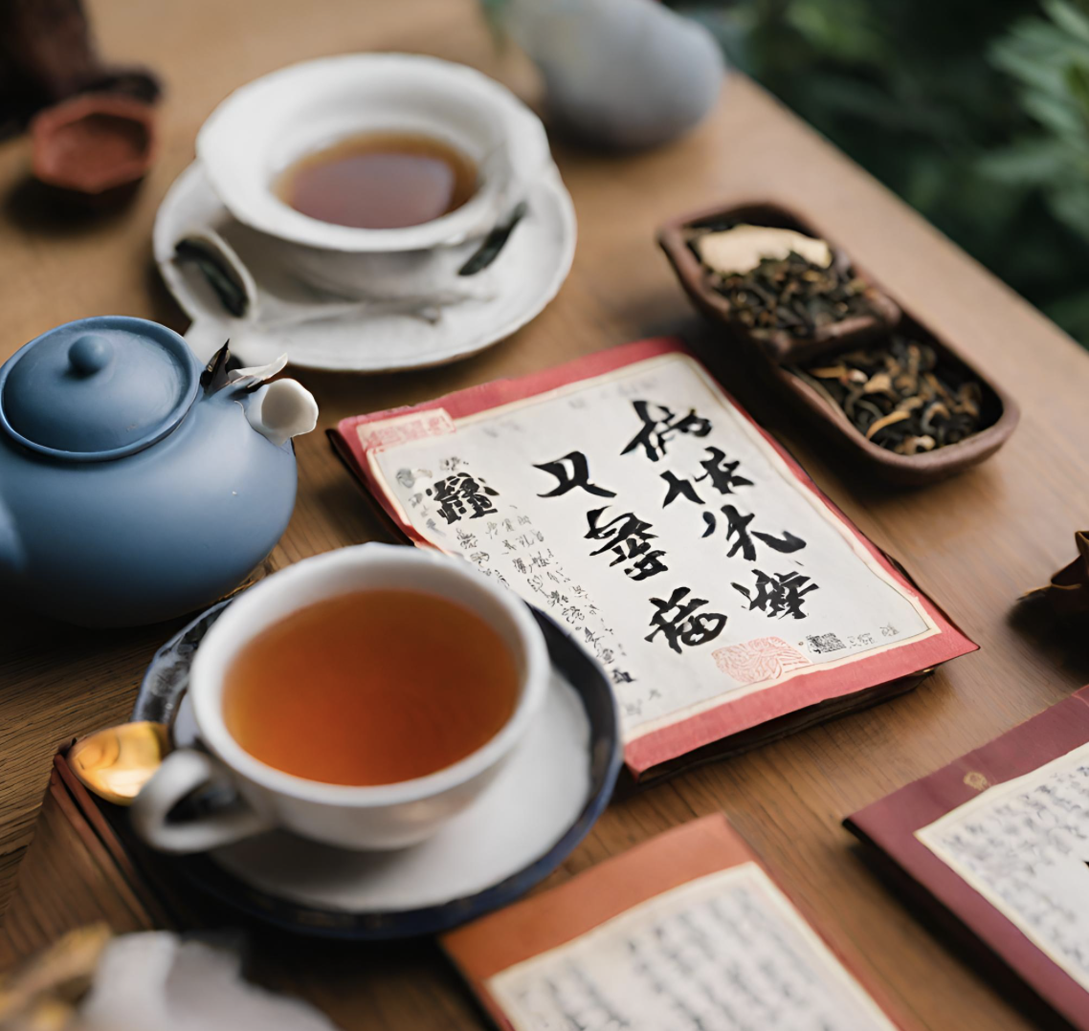
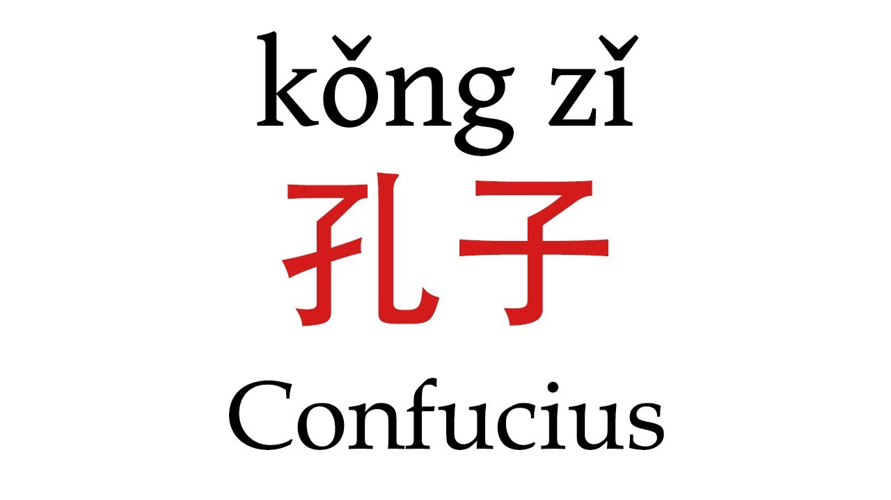
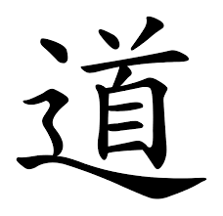
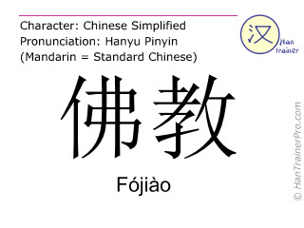
Religion and Tea
There are different types of teas that correspond to different types of Chinese beliefs.
Taoism tea, Buddhism tea, Confucianism tea, and vulgar tea to name a few.
Tea is used to express beliefs while also quenching thirst.

Slide 8
Tea Ceremonies
Confucianism emphasizes the importance of harmony, respect, and etiquette, which is reflected in the tea ceremony. (1)
It expresses spirituality and allows people to connect with each other on a deeper level
Tea can help meditation
Serving tea to another is a sign of respect in Confucianism morality
Lu Yu, Tang dynasty scholar, wrote “The Classic of Tea” which tied tea drinking to spiritual matters and Chinese way of life. (1)
https://en.wikipedia.org/wiki/Chinese_tea_culture

Slide 9
Healing Properties of Tea
Helps aid weight loss and increases muscle growth (1)
Antioxidant properties that fight off diseases such as Alzheimer’s (2)
Anti-inflammatory properties that reduce risk of heart disease (2)
Increased oral health (3)
Better digestion (3)
Better bone health (3)
Increased memory and brain power (3)
https://www.ncbi.nlm.nih.gov/pmc/articles/PMC4032838/
https://www.borntea.com/blogs/tea/10-benefits-of-drinking-chinese-tea-you-should-know
https://tecompanytea.com/blogs/tea-atelier/health-benefits-of-tea-in-chinese-medicine

Slide 10
China vs America on Tea vs Coffee
China:
Tea is more popular, but coffee is widely accepted
Hometown of tea
Art of tea originated with the Tang Dynasty (2)
Tea is spiritual
There are some social aspects to tea in China
America:
Coffee is more popular, while tea isn’t
Made iced tea and tea bags (1)
Boston tea party is a huge event in American history.
Coffee is used mainly to stay awake, and some social aspects
https://www.teamuse.com/article_050701.html 2. https://en.wikipedia.org/wiki/Chinese_tea_culture

Slide 11
How to Make Tea, the Tang Way
During the Tang Dynasty, 618-907AD: (1)
Find high quality leaves to make green tea, which is popular
Boil water with a kettle and crush the leaves into a fine powder
Sprinkle powder into water and season with salt, ginger, or mint
Whisk the tea with a bamboo whisk until it froths
Serve
Simple and cheap to make, not many ingredients required
https://en.wikipedia.org/wiki/Chinese_tea_culture

Slide 12
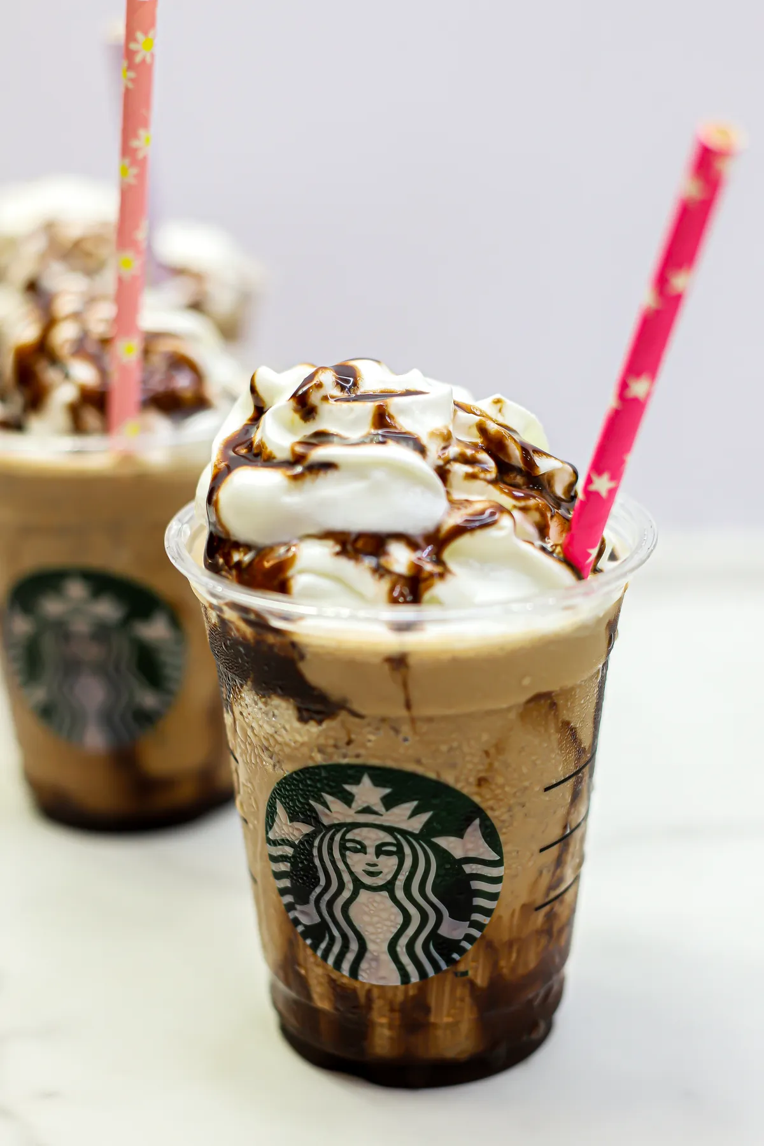
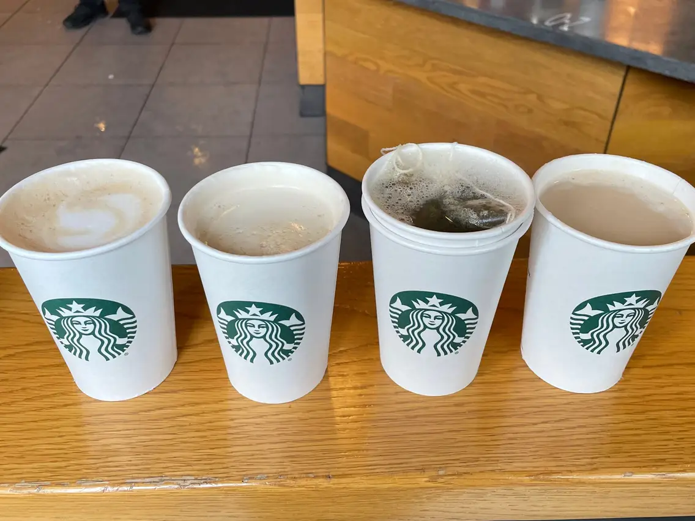
Bubble Tea vs Traditional Tea
Bubble Tea was introduced to China in the 1980s and 1990s and has since spread globally
Thanks to social media trends and the internet
Bubble tea is often way more sugary and flavorful than traditional tea. Think of a Frappuccino at Starbucks vs a regular roast.

Slide 13
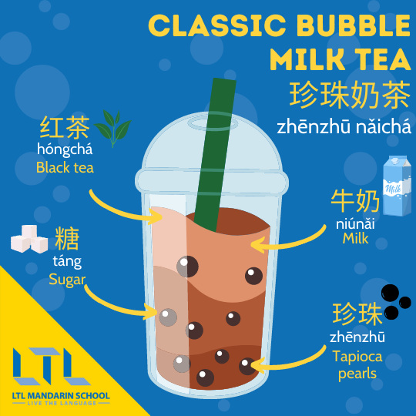
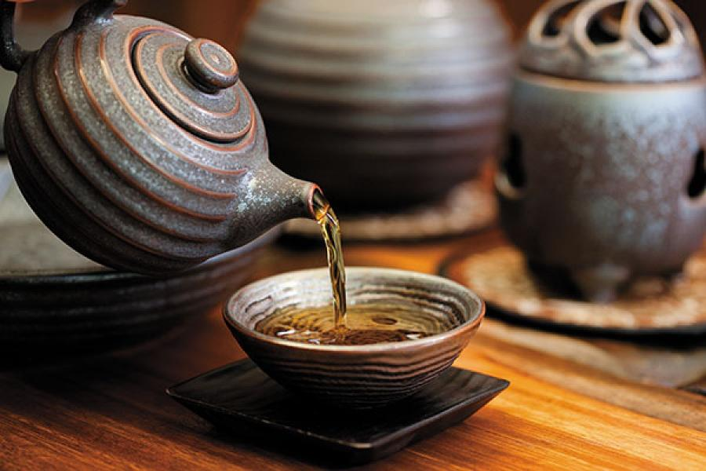

Slide 14
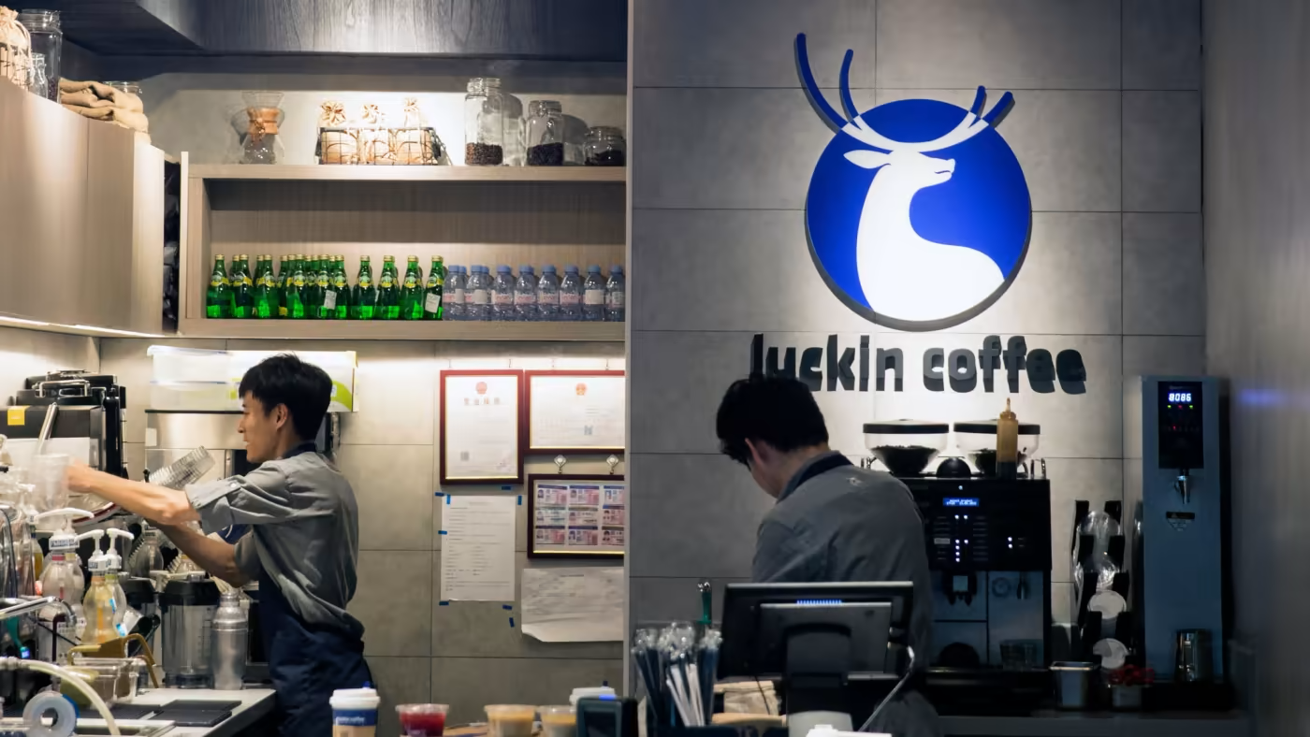

Slide 15
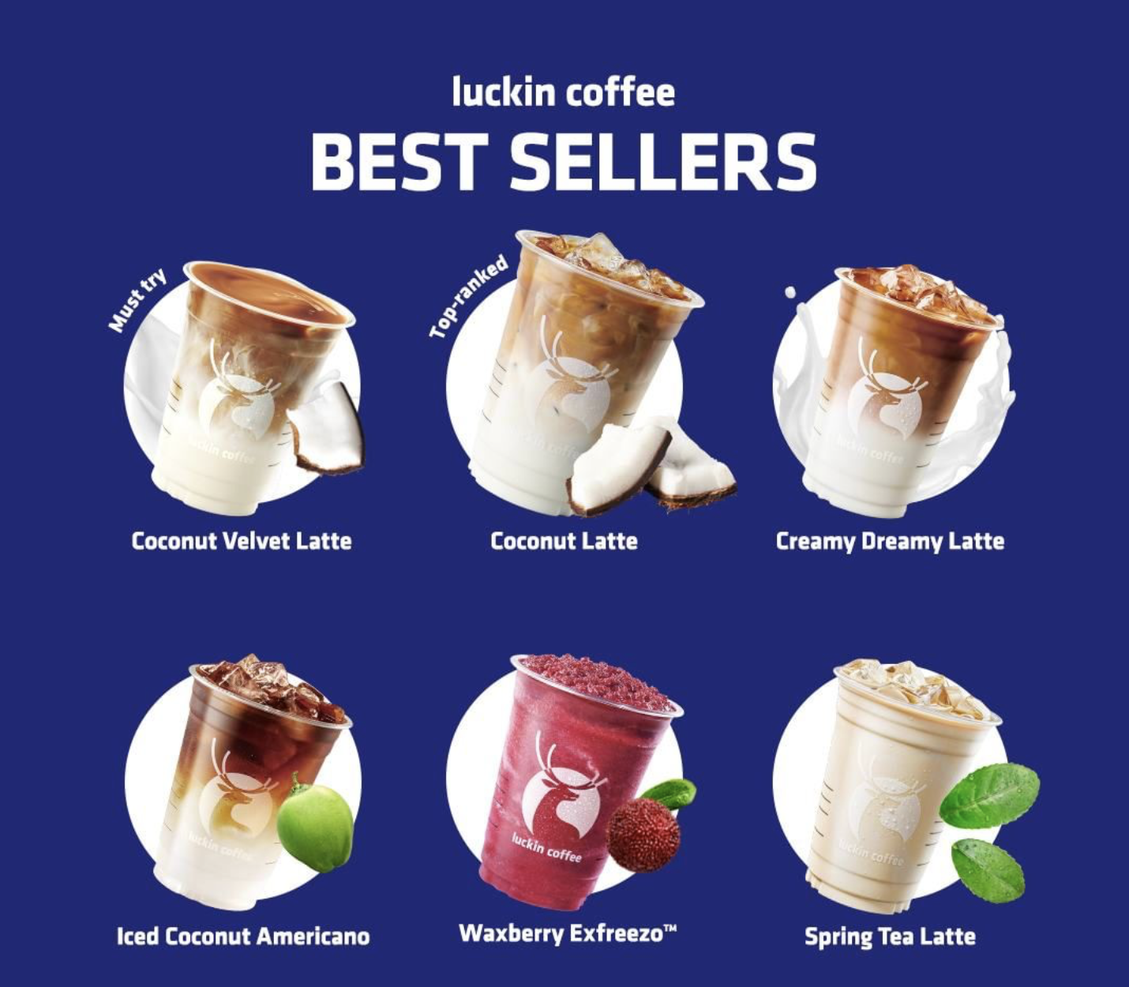
Luckin Coffee, Chinese Starbucks
Cheaper than Starbucks
10.8k stores in China compared to Starbucks having 5.6k (1)
Controversy in the past due to a fraud scandal in 2019
https://www.cnn.com/2022/05/25/investing/china-luckin-coffee-earnings-q1-2022-intl-hnk/index.html

Slide 16
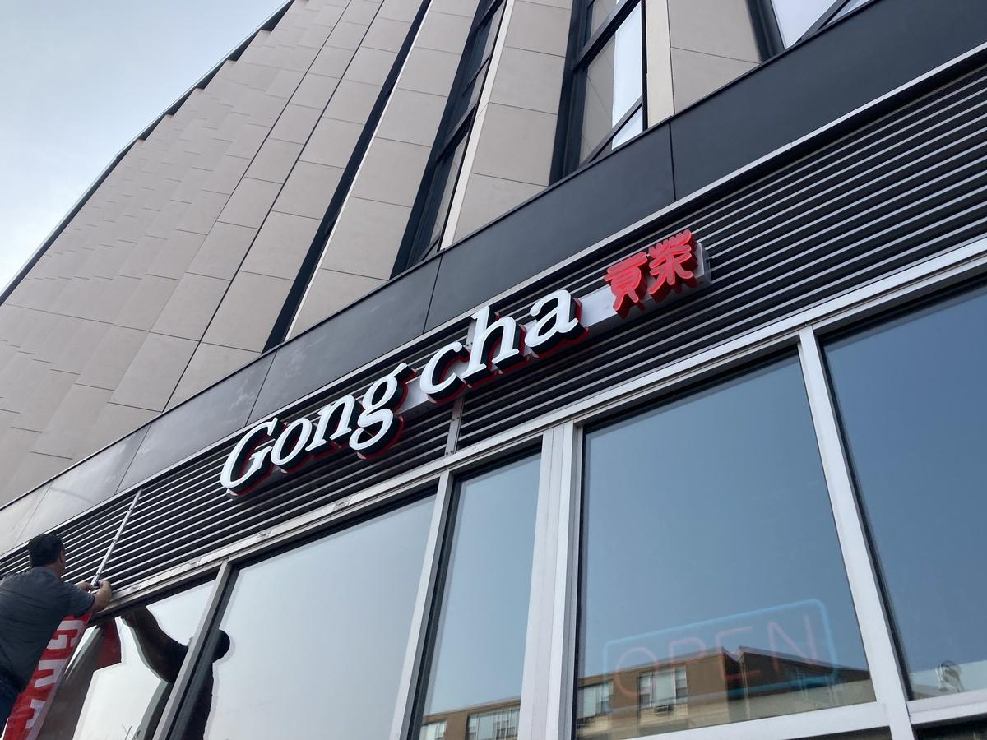
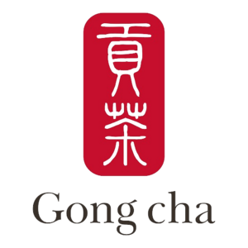
Tea at LUC

